Slide 1
The National Performance Framework and UN Sustainable Development Goals

Slide 2
www.nationalperformance.gov.scot
https://sustainabledevelopment.un.org/

Slide 3
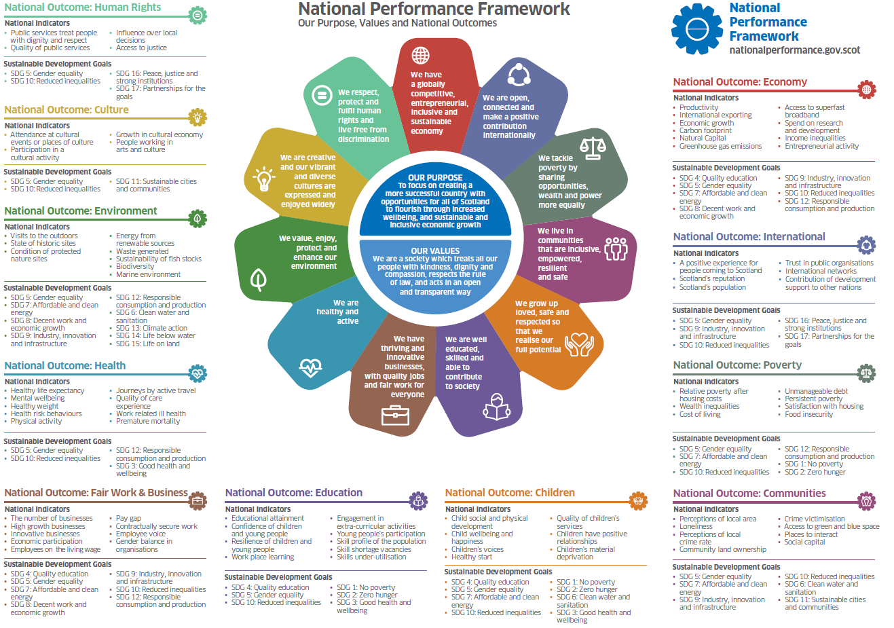
11 Outcomes, 81 Indicators and linked SDGs

Slide 4
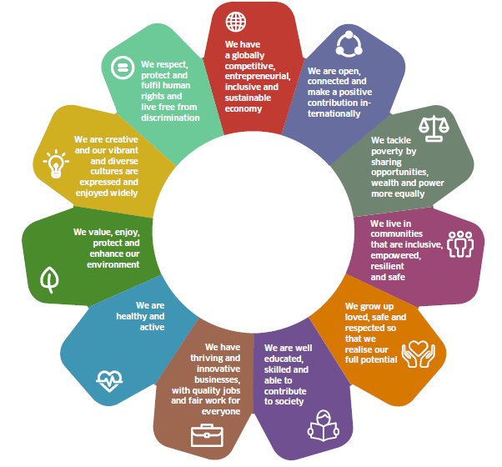
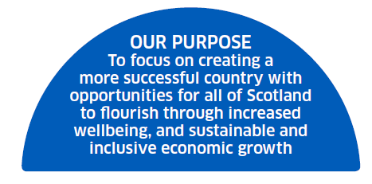
Definitions: What are the different elements of the NPF & what can they tell us? (1)
11 National Outcomes: These describe the features of the kind of Scotland we want to create as a consequence of our collective actions. They are population level end results we want to be experienced by the people of Scotland. They have a statutory basis in the Community Empowerment (Scotland) Act 2015.
Values statement: inform the behaviours people in Scotland should see in everyday life and are part of a commitment to improving individual and collective wellbeing. Help with what to prioritise and how to behave to get there.
Purpose statement: The “reason for being” of the NPF, giving long term aim and direction.

Slide 5
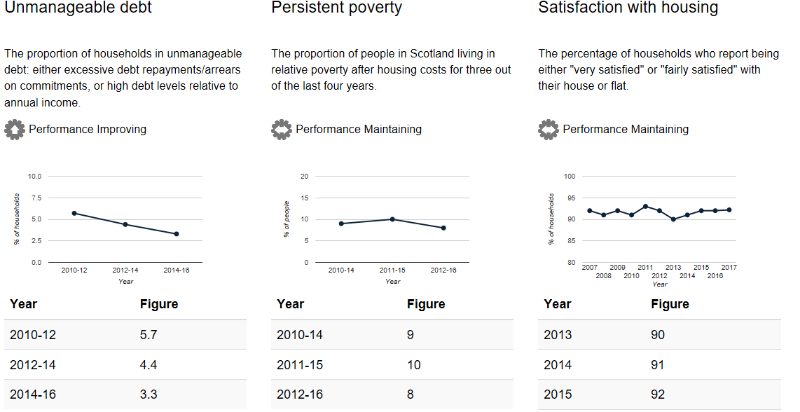
Definitions: What are the different elements of the NPF & what can they tell us? (2)
81 National Indicators: Give a broad picture of progress towards the outcomes on some important measures (at the national level and also for population sub-groups).
While they are important to measure, they are not the only important measures of progress towards Scotland’s National Outcomes, and whether Outcomes are being realised for all requires exploration of performance differences and gaps between groups through the Equality Evidence Finder.
There are risks and unintended consequence of focussing too much on the Indicators themselves rather than the Outcomes; the Indicators are best seen as one important source of evidence that paint a broad picture of “how we’re doing” socially, economically, and environmentally.

Slide 6
Where are we on the NPF journey?
In Statute – The Community Empowerment (Scotland) Act 2015 places a duty on Scottish Ministers to consult on, develop and publish National Outcomes for Scotland and to review them every five years.
It also places a duty on public authorities to have regard to the national outcomes in carrying out their functions.
Belongs to the whole of Scotland, not just an SG framework. Everyone has a role to play in contributing to the delivery of the National Outcomes.
Embeds the SDGs to get us to 2030
17 Goals mapped against the 11 National Outcomes
SDG indicators aligned to NPF indicators where appropriate and possible

Slide 7
How can I use the NPF?
National
Outcomes/
SDGs
Intermediate Outcomes
Priorities and planning
Evaluation
& reporting
Action plan
Implement
STEP 1: National Outcomes/SDGs ‘Contribution Story’: Explain the linkages your work/policy area has to the National Outcomes and associated Sustainable Development Goals.
STEP 2: Intermediate Outcomes: Together with your partners identify what your intermediate (i.e. policy or programme level) outcomes are.
STEP 3: Priorities and planning: What do the evidence and your partners tell you about where we are in Scotland in achieving these intermediate outcomes? Where are we most falling short?
STEP 4: Action plan: Based on your priorities, develop a plan of action based on the evidence and a strong theory of change.
STEPS 5 and 6: Implementation, evaluate and report: Monitor and evaluate the implementation of your activities as robustly as possible.

Slide 8
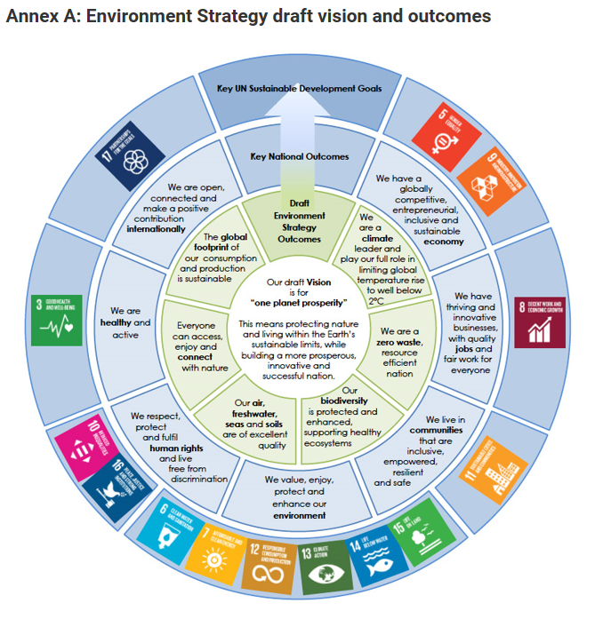
Contribution Story
… contributing to a range of National outcomes and associated SDGs where evidence and partners’ views tell credible contribution story.
… setting out vision
… set of intermediate outcomes, constructed with and co-owned by partners
https://www.gov.scot/publications/developing-environment-strategy-scotland-discussion-paper/

